Slide 1

2021 HD Research Update:
The path forward
Vicki Wheelock MD
Sasha Duffy DO
Rebecca Craig MSHS, CCRP
HDSA Center of Excellence
at UC Davis
Northern CA HDSA Family Education Day
May 8, 2021

Slide 2
Outline
Recent news in HD research:
Vaccinex, Roche and Wave
Important current trials
What’s on the horizon

Slide 3

The importance of finding treatments for HD
Progressive, hereditary degenerative neuropsychiatric disease
Two FDA-approved therapies for chorea
No disease-modifying therapies exist to delay onset or slow progression
Dr. Nancy Wexler with JoHD patient in Venezuela

Slide 4
1. The road map for research development
Developing the approach
Delivering the treatment to the brain
Anticipating side effects
Measuring effectiveness

Slide 5


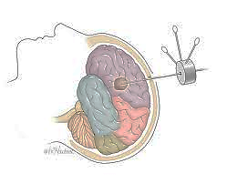
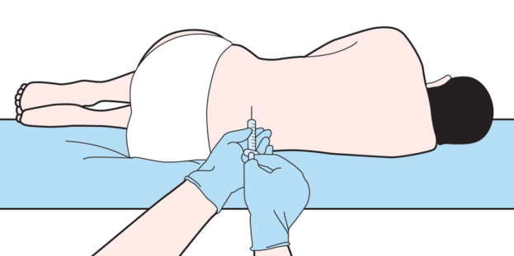
2. Delivering the therapy to the brain
Pill, tablet or capsule
Monthly Intravenous therapy
Lumbar puncture/spinal tap
Intracranial delivery/brain surgery
Vaccinex
PROOF-HD
WAVE, ROCHE
uniQure

Slide 6
3. Anticipating side effects
Delivery
Off-target effects
The need for clinical trials
Special considerations: juvenile onset HD

Slide 7
4. Measuring effectiveness
Clinical measures:
  Cognition
  Behavior and mood
  Chorea and motor control
  Functional decline
Biomarkers:
  mutant huntingtin levels in the spinal fluid
  Neurofilament light (NfL)
  MRI brain scan

Slide 8

Recent research news:
A very difficult year
Sep. 2020
SIGNAL-HD study of VX-15 failed.
22 Mar. 2021
Roche/Genentech announced that dosing in Generation HD-1 trial was halted.
29 Mar. 2021
Wave Life Sciences announced that their trials failed.

Slide 9
Similarities and differences
Both Roche Generation HD-1 trial and WAVE Precision HD-1 trials used antisense oligonucleotides designed to lower mutant huntingtin levels
Both were delivered via spinal tap into the cerebrospinal fluid, with the drug then absorbed into the brain and spinal cord

Slide 10
Similarities and differences
Roche Generation HD-1
Phase 3 trial: 791 participants
Wave PRECISION-HD trials
Phase 1 trials, 60 patients
Lowered both mutant and wild type huntingtin
Dosing halted; study on-going
Lowered only mutant huntingtin
Studies completed; failed to lower mutant huntingtin

Slide 11

Huntingtin-lowering therapies
What happened?
Many theories
Roche plans to complete trial and study all data to better understand why the approach wasn’t working
WAVE Life Sciences has developed a 3rd ASO with innovations

Slide 12
Current HD research studies
ChANGE-HD
KINECT-HD
PROOF-HD
uniQure
ENROLL-HD

Slide 13


Kids-JHD study is a brain imaging study looking at brain structure and function in kids at risk for HD and those with JHD
Peg Nopoulos at the University of Iowa
First study of kids at risk, ages 6 – 18 years
Kids-HD is now ChANGE-HD

Slide 14

Child to Adult Neurodevelopment in Gene Expanded Huntington’s Disease
Funded by the National Institute of Neurologic Disease and Stroke (NINDS) for 5 years
Imaging study for brain structure and function in kids and young adults at risk for Huntington’s disease, Ages 6 – 30 years

Slide 15

ChANGE HD
Study participants will undergo a brain MRI, cognitive tests, behavior assessments and physical and neurological evaluations on a yearly basis.
The MRI studies brain structure, while other assessments follow brain function.
The analysis will compare the structure and brain function of those at risk for Huntington’s who have CAG repeats of 40 and above to those who have a repeat length of 39 or less.

Slide 16
ChANGE HD
Replicate Kids-HD findings, good science can and needs to be replicated in a larger group of people
Enroll a bigger sample size
Include the entire period of brain development and address the lack of data in the young adult age range

Slide 17
Brain Development
mHTT has a direct effect on potential intelligence.
If the brain continues to mature up through age 30, when is full potential reached?
How do we determine the best timing for therapeutic interventions to prevent disease?
Peg Nopoulos Lab | Institute for Clinical and Translational Science Carver College of Medicine | Department of Psychiatry | University of Iowa

Slide 18
ChANGE HD Participation
Kids and young adults at risk for HD (parent or grandparent), ages 6 – 30 years
If < 18 years of age, will need to bring a parent or guardian
Participants are paid for their time and effort
A study day takes about 6-8 hours
All travel arrangements are handled by study staff, travel-related expenses paid in advance or reimbursed
Participants who have already had genetic testing are encouraged to keep their status undisclosed to study staff

Slide 19
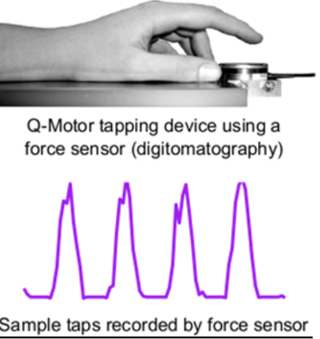
ChANGE HD Study Visits
MRI brain imaging overseen by team of imaging experts
Blood samples for analysis and biobanking, including looking at Neurofilament Light (NfL) as a potential biomarker
Interactive computerized neurocognitive assessment on touch screen iPAD
Sensitive fine motor evaluation using Q-Motor and Q-Cog technologies

Slide 20
ChANGE HD Sites
The University of Iowa – Iowa City, IA
Penn Medicine and the Children's Hospital of Philadelphia – Philadelphia, PA
Columbia University Medical Center – New York, NY
The University of Texas Health Science Center at Houston – Houston, TX
UC Davis Medical Center – Sacramento, CA

Slide 21




Enrolling NOW!
Location:
UC Davis Medical Center
4860 Y Street
Suite 3700
Sacramento, CA | 95817
/ChangeHDresearch
changehd.org
change-hd@uiowa.edu
Phone: 866-514-0858 | 916-891-1233

Slide 22

What is the KINECT-HD Study?
A double blind, randomized, placebo- controlled clinical trial.
A research study (clinical trial) studying:
  The effectiveness of valbenazine to reduce chorea associated with Huntington’s disease
(HD).
  The safety and tolerability of valbenazine in individuals with HD.

Slide 23
Who can participate?
KINECT-HD will enroll approximately 120 participants who must meet several criteria, including:
  Male or female, ages 18-75 years
  Diagnosis of motor manifest Huntington’s disease
  Have bothersome or troublesome chorea (that meets the study protocol requirements)
  Willing and able to comply with study instructions and procedures

Slide 24
How long is the study?
Participation in this study consists of 9 total study visits that will last up to 18 weeks. Visits include:
Up to 4 weeks of screening
12 weeks of study drug dosing
A final study visit 2 weeks after the last dose of the study drug (valbenazine or placebo).

Slide 25



What are the most common side effects from valbenazine?
  Drowsiness
  Tiredness
  Sedation (feeling calm, relaxed or sleepy)

Slide 26

At the conclusion of the trial, the study team will analyze the data and determine if valbenazine is safe, well tolerated and effective in treating chorea in individuals with HD.

Slide 27

PRidopidine’s Outcome On Function in Huntington Disease
Phase 3, randomized, double-blind, placebo-controlled study evaluating the efficacy and safety of pridopidine in patients with early stage of Huntington disease.
Pridopidine is a small molecule developed by Prilenia for the treatment of neurodegenerative disorders such as HD. Pridopidine binds and activates the Sigma-1 receptor (S1R) and may be neuroprotective.
Previously used in PRIDE-HD study

Slide 28
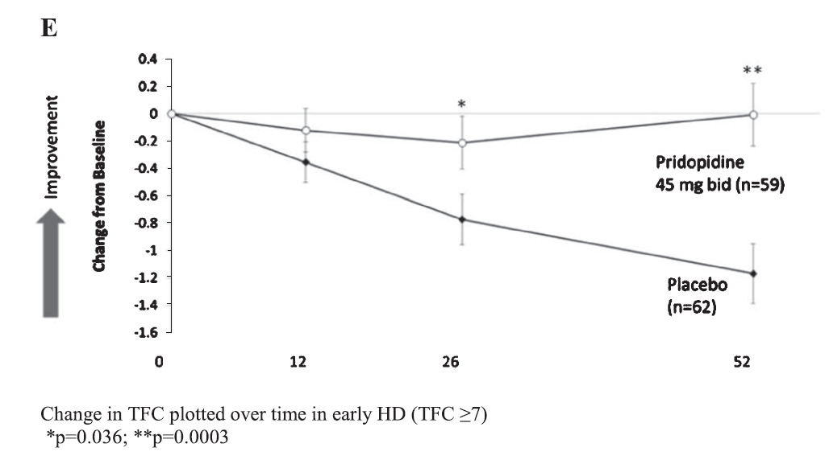
McGarry et al. Effects of Pridopidine on Functional Capacity in Early-Stage Participants from
the PRIDE-HD Study. Journal of Huntington’s Disease 9 (2020) 371–380

Slide 29
Eligibility:
  > Male or female, 25 years of age and older, capable of giving informed consent.
  > Have a diagnosis of HD based on clinical features.
  > Have confirmed presence of CAG repeats of 36 or greater in the huntingtin gene.
  > Must have adult-onset HD with onset of signs and symptoms at, or later than 18 years of age
  > Must be willing and able to comply with the study instructions.

Slide 30
Study design:
  Screening period
  Randomization: active pridopidine or placebo 45 mg tablet twice daily
  Open label extension is planned
  Duration: 65 weeks (15 months)

Slide 31

AAV5-miHTT = AMT-130
The study medication is an artificial micro-RNA specifically tailored to reduce huntingtin messenger RNA.
This drug, AMT-130, is packaged with Adeno-Associated Virus (AAV)Type 5, designed to enter brain cells and direct them to permanently produce the micro-RNA that reduces the production of both wild-type and toxic HD protein.
Administered directly to the brain target via single neurosurgery procedure.
The therapy will be permanent, and the effect is predicted to be long-lasting
http://uniqure.com/gene-therapy/huntingtons-disease.php

Slide 32
AMT-130 Study
First-in-human study
Single neurosurgical administration of AMT-130
  Cohort 1: Low-dose vs placebo
  Cohort 2: High dose vs placebo
  Control group: “imitation surgery” for both cohorts
Blinded study: the patient, care partner, investigator and outcomes assessor will not know the treatment assignment
Duration of study: 12 months blinded Core Study period, 5 years follow-up in total
Primary outcome measure: Safety and tolerability
Other assessments: clinical rating scale of HD signs and symptoms, brain MRI scan, lumbar puncture for measurement of mutant huntingtin protein levels
ClinicalTrials.gov Identifier: NCT04120493

Slide 33

AMT-130 Study
Number of patients in study = 26
Eligibility:
  Men and women, ages 25 – 65
  Early-stage manifest HD
  CAG repeats 40 or higher
  MRI brain scan shows adequate size of brain target for implantation
  Stable medical status and medications for HD
  No medical contraindications to MRI, lumbar puncture, brain surgery
ClinicalTrials.gov Identifier: NCT04120493

Slide 34

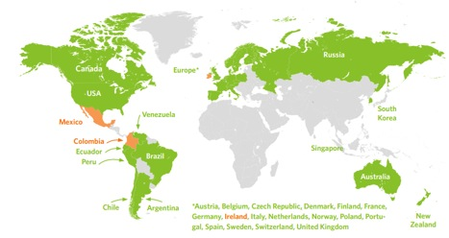
The goal of Enroll-HD is to accelerate the discovery and development of new therapeutics for HD
Active Participants: 19, 666
Clinical Sites Worldwide: 158
Nations Participating: 7

Slide 35

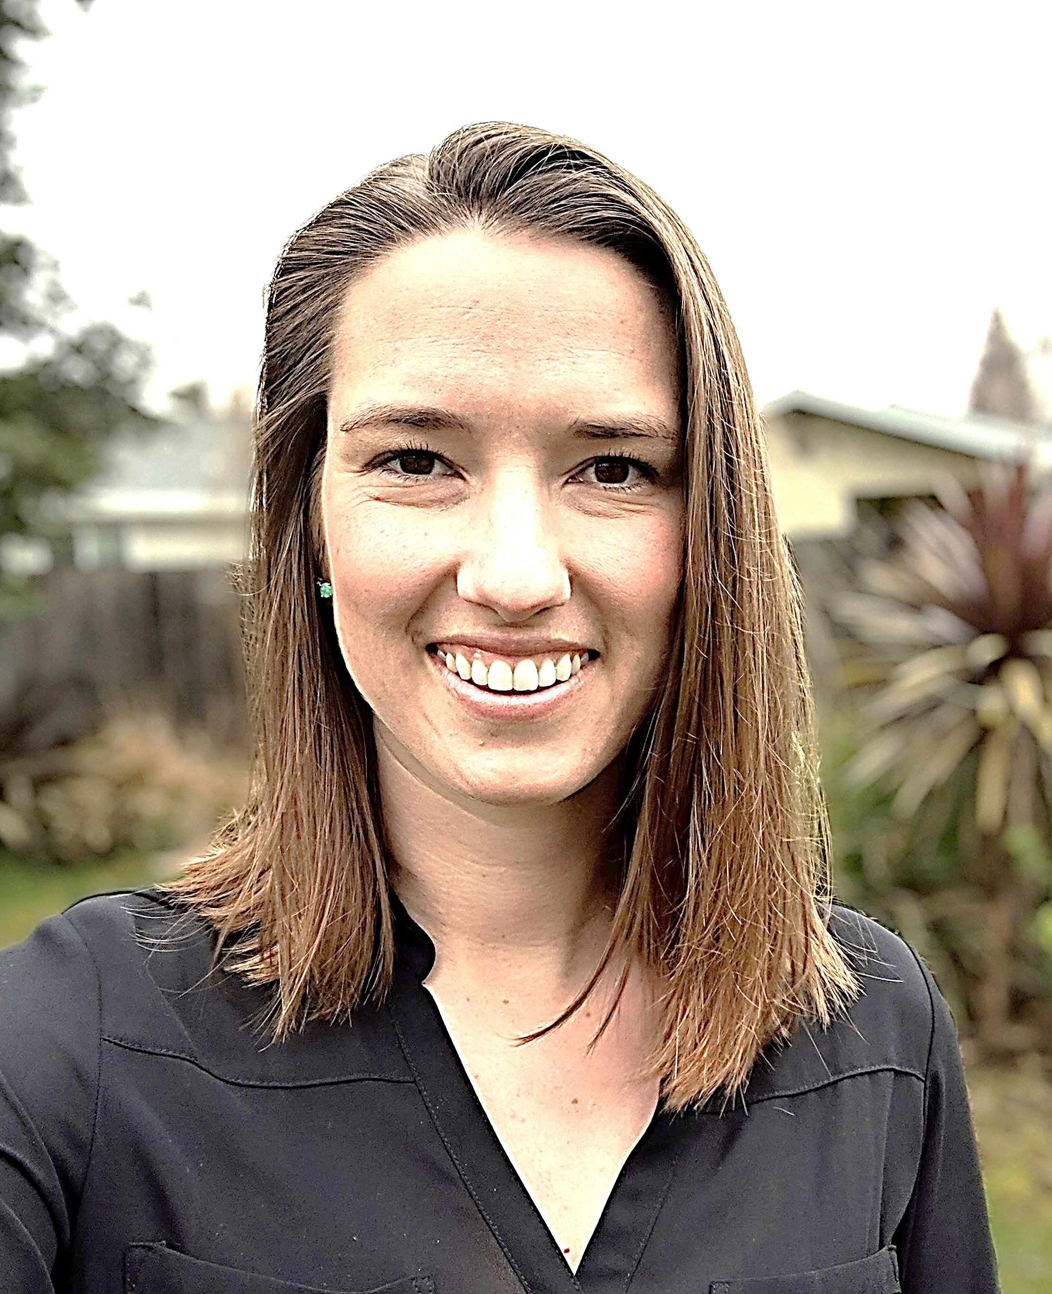
Current HD clinical trials and observational studies
ChANGE-HD
KINECT-HD
PROOF-HD
ENROLL-HD
uniQure AMT-130
7-Tesla MRI Study
UC Davis
UC Davis
Sadie Rogers
ssrogers@ucdavis.edu
(916) 734-6278
UC Davis
UC Davis, Stanford, UCSF
UCSF
Becky Craig
rscraig@ucdavis.edu
(916) 734-3541
UCSF

Slide 36
Other regional
HD research contacts
UCSF
Julia Glueck, BS Theresa Driscoll
(415) 502-7640 (415) 514-0191
Julia.Glueck@ucsf.edu Theresa.Driscoll@ucsf.edu
- UniQure AMT-130 - ENROLL-HD
- 7-Tesla MRI Study
Stanford
Angela Bayot, RN
HD Clinic Coordinator
(650) 723-6060

Slide 37

Strengths in research progress
We understand the natural history of HD
Robust involvement of the HD community in HD research
Major research breakthroughs
Multiple sponsors and companies are targeting HD

Slide 38
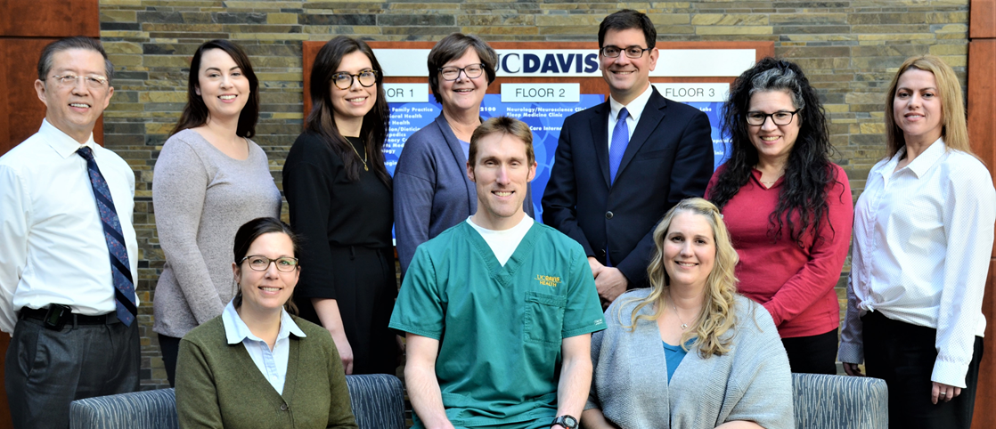
Thank you to HD patients, families and care partners
We are grateful to The Northern CA Chapter of HDSA and to patients and families with Huntington’s disease for your passion and support for care and research for Huntington’s disease
Our work in HD has been inspired and generously supported by the Joseph P. Roberson Foundation, The Charles and Margaret Pue Foundation, HDSA, and HD patients and family members

Slide 39
Questions?

